Slide 1

Forecast gold price for next 30 days
Mentor : KARTIK
Date : 14-04-2022
Group-3 members :
H. VISHAL
H. SHIVA NANDINI
NILAKANTHA PANIGRAHI
CHANDRIKA KJ
DEEPAK KUMAR SHARMA

Slide 2
Business problem :
Forecasting of gold price for next 30 days.
OBJECTIVE :
Based on the time series data provided we have to build a forecast model to predict the gold price so that the importing and exporting companies can set their revenues accordingly.

Slide 3
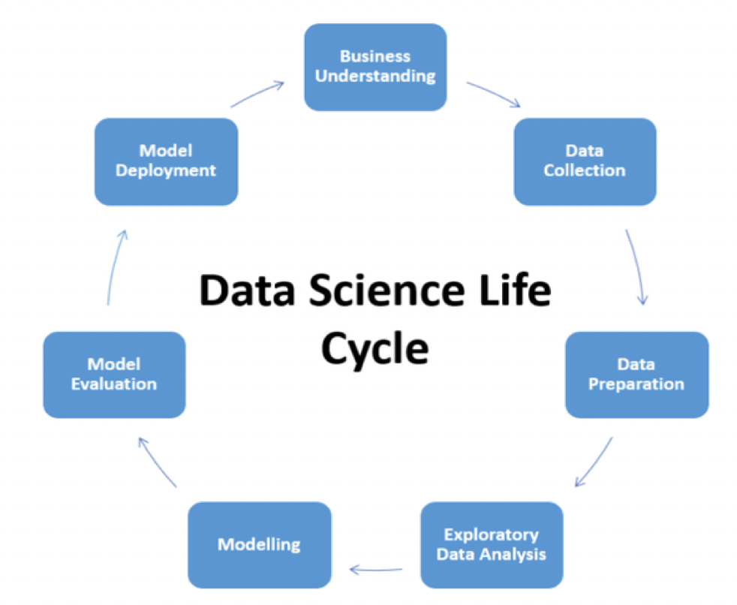
Project architecture :

Slide 4
Dataset details :
Time series dataset (1-jan-2016 to 21-dec-2021)
Rows = 2182
Columns = 2
Missing values = No missing values
Time interval = Daily

Slide 5
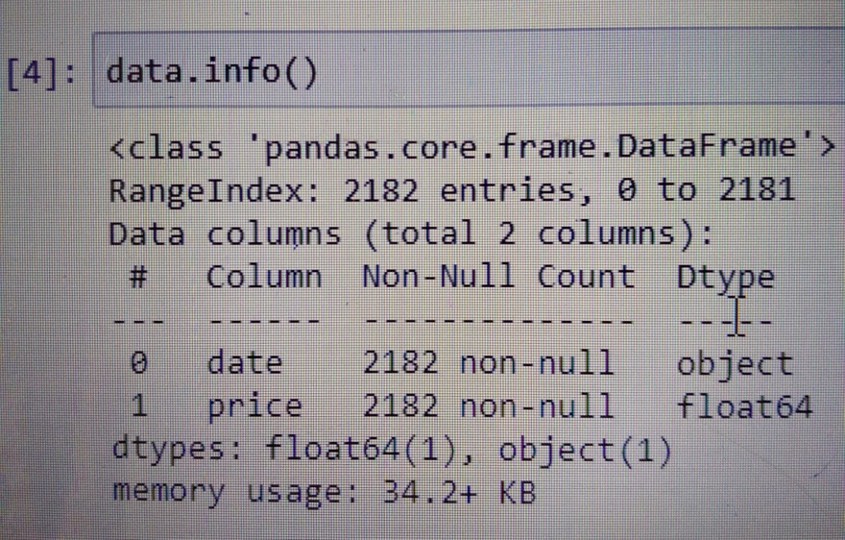
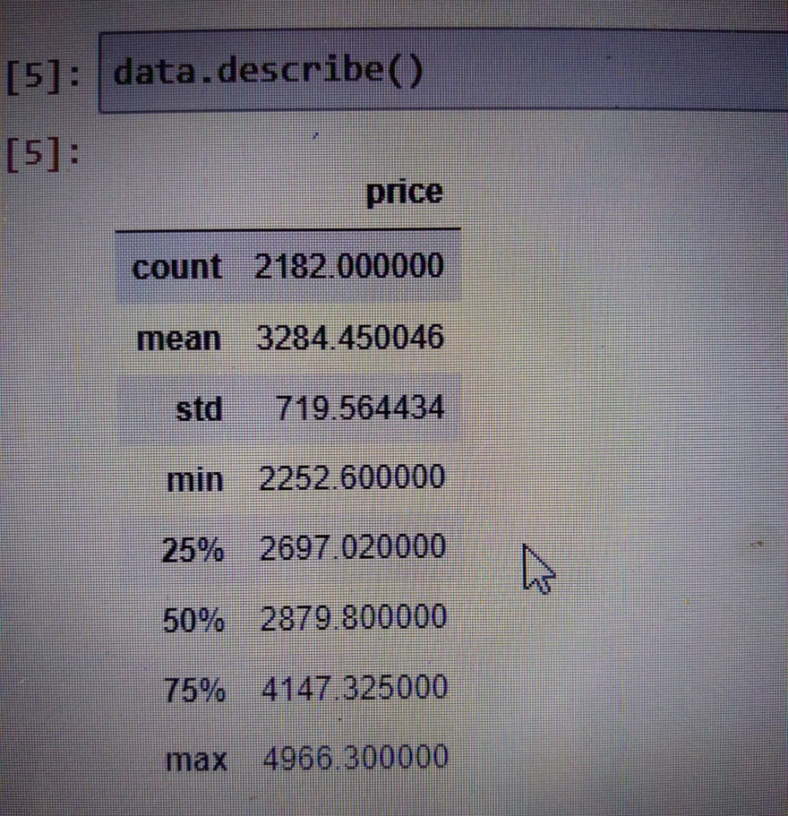
Data set details :

Slide 6
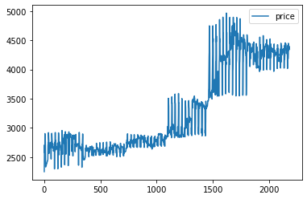
EDA :
Observed it has upward exponential trend
Additive seasonality
No outliers

Slide 7
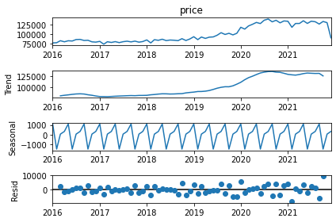
With the below graph we can see trend and seasonality existing for the given data

Slide 8
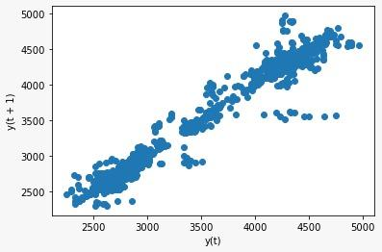
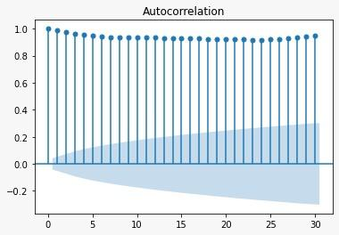
Visualization :
LAG PLOT
ACF PLOT

Slide 9
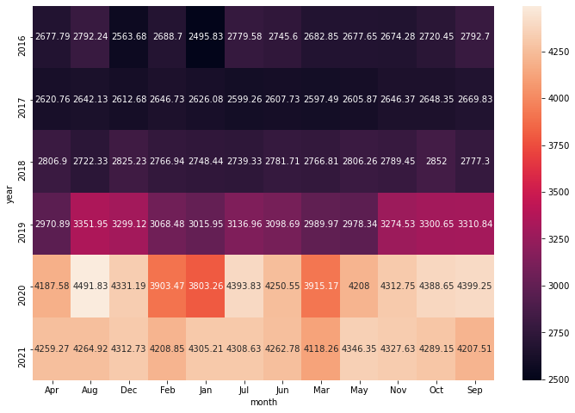
Heat map :

Slide 10
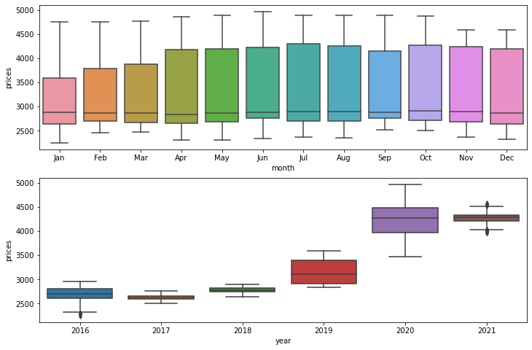
Boxplot :

Slide 11
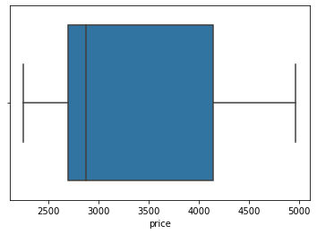
As we see no outliers for daily variation of price of gold , and our objective is to forecast for daily range , so we need not treat outliers.

Slide 12
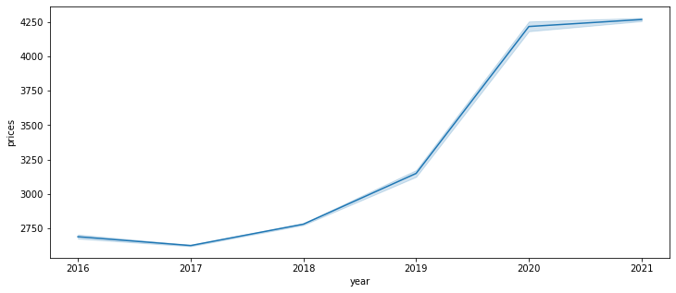
Line plot :

Slide 13
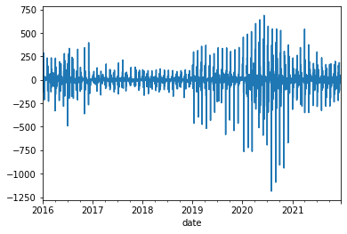
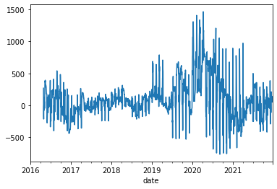
Differentiating to remove trend
Removing Seasonality

Slide 14
MODEL BUILDING

Slide 15
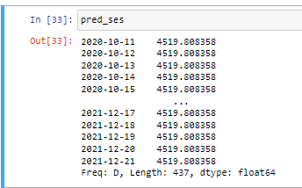
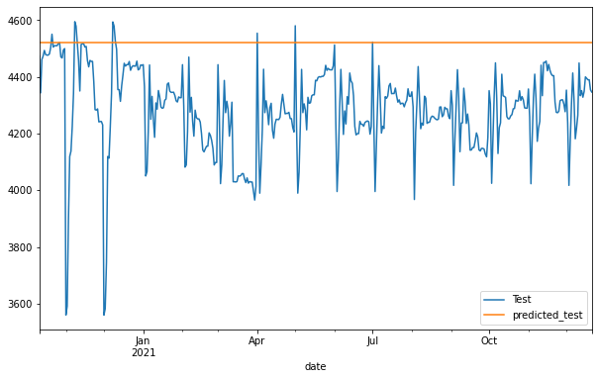
Simple Exponential Smoothing
Since SES model does not take into account trend and seasonality , we only get a level prediction using this model. Thus it cannot be used to build final model to predict gold price for next 30 days.

Slide 16
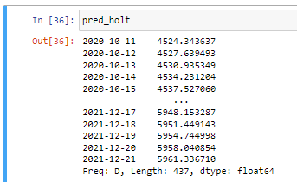
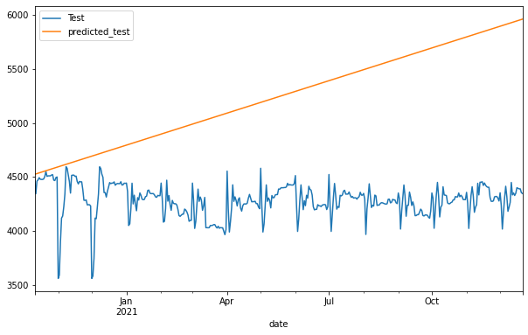
Holt's model
Holt's model takes into account the trend present in the data but not the seasonality and hence predicts the trend values in the given data.

Slide 17
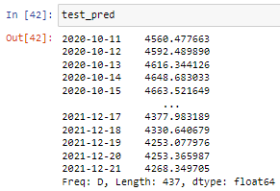
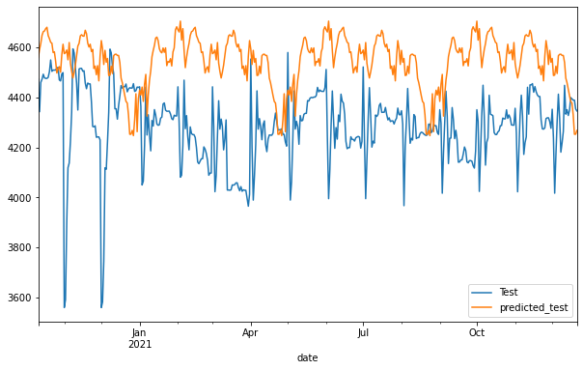
Holt- Winter's model​
Holt Winter's model takes into account both trend and seasonality. As we can see the predicted data is following the seasonality as present in test data.
Also the MAPE value obtained was 6.2, which is reasonable value to use use the model as final model.

Slide 18
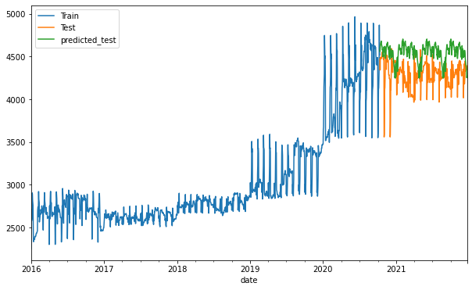

Slide 19
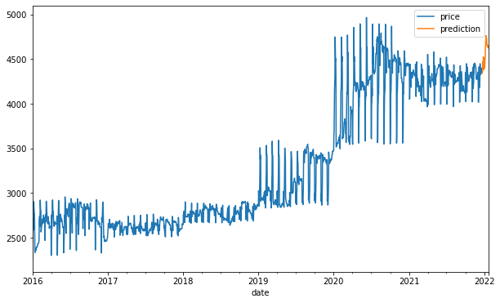
MODEL PREDICTION

Slide 20
MODEL DEPLOYMENT USING STREAMLIT

Slide 21
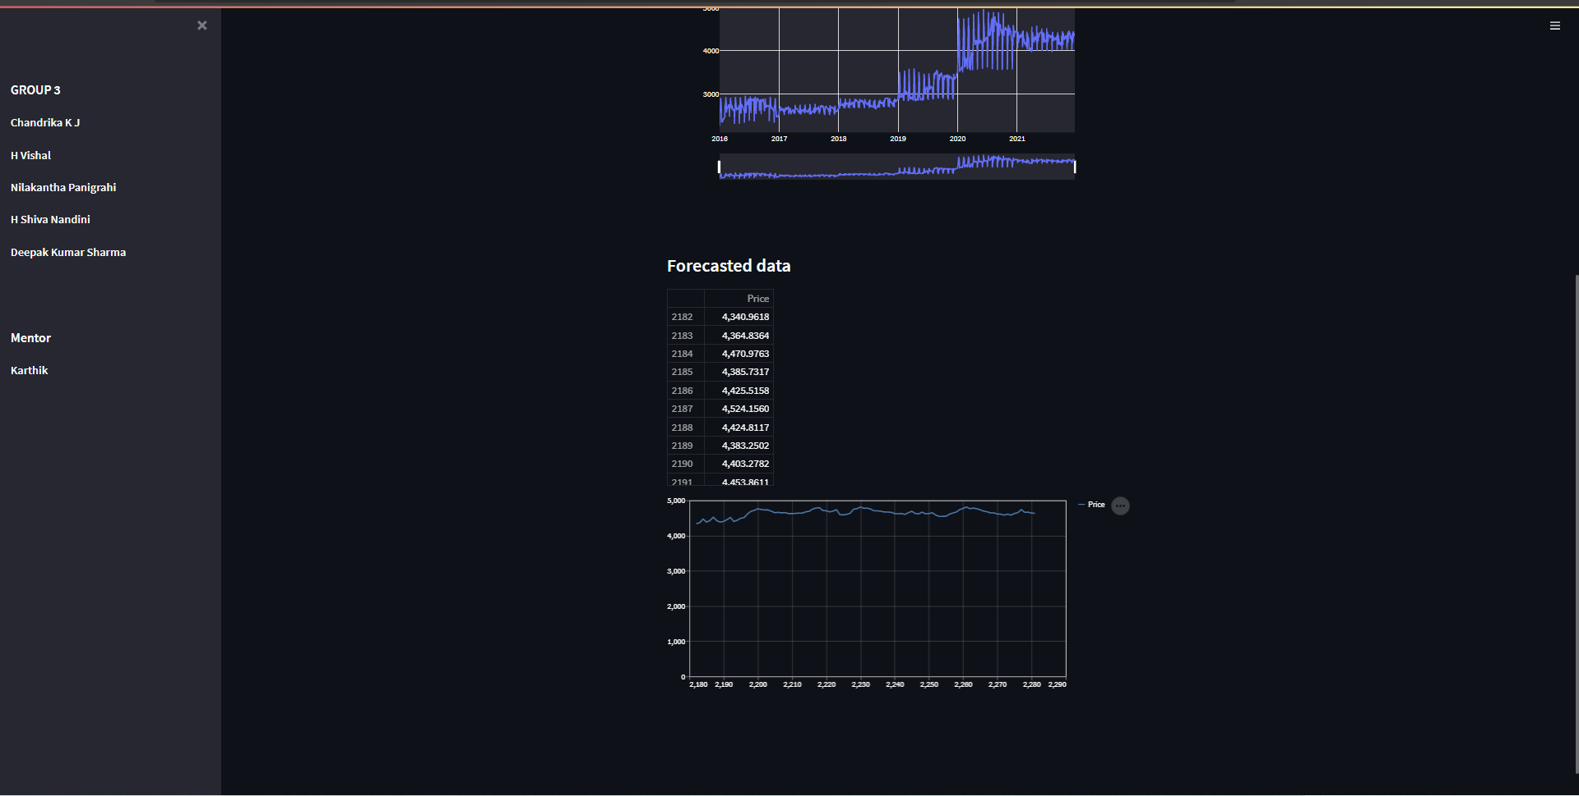

Slide 22
CHALLENGES FACED DURING PROJECT
Understanding Seasonality in the data was a major issue and we had to try with different differencing methods to come to a conclusion of additive seasonality in the time series data.
Deployment using platforms other than streamlit was challenging.

Slide 23
Thank you...

